Slide 1
Microsoft Power BI

Slide 2
Modern React-JS Development with App-Owns-Data Embedding
Ted Pattison
Principal Program Manager
Power BI Customer Advisory Team (PBICAT)

Slide 3
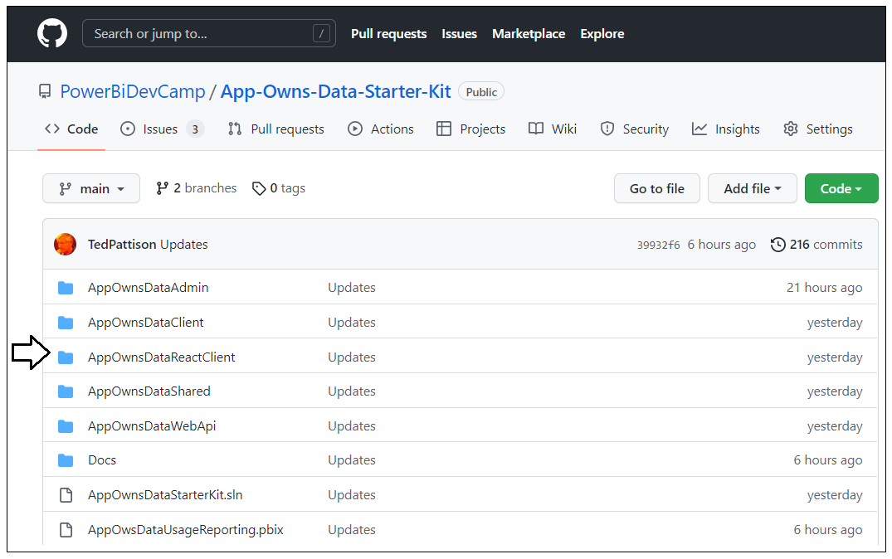
Developer Sample used in This Session
AppOwnsDataReactClient is included as part of the App-Owns-Data Starter Kit
App-Owns-Data Starter Kit is developer sample demonstrating App-Owns-Data embedding
Originally published in July 2021 - Updated in October 2022 with AppOwnsDataReactClient
AppOwnsDataReactClient built using React-JS, Material UI, MSAL.js Typescript and webpack

Slide 4
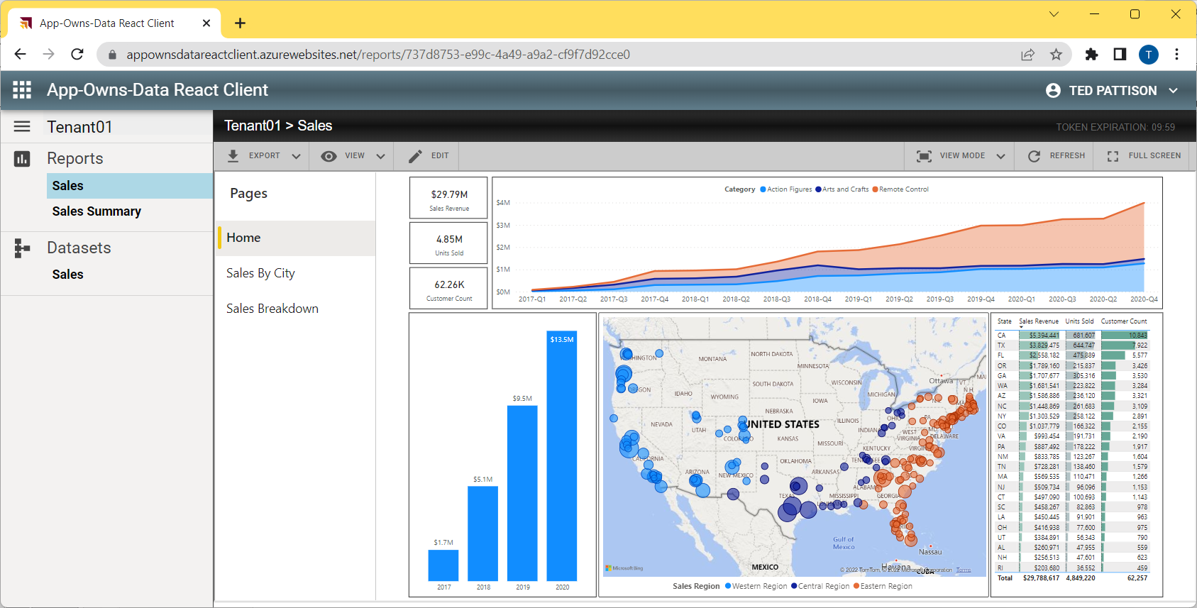
Intro Demo of AppOwnsDataReactClient

Slide 5
Agenda
Quick Review of Modern React
App-Owns-Data Starter Kit Architecture
Designing a View Model for a Multitenant Application
Designing a Functional Component for Embedding Reports
Managing Embed Token Expiration
Providing Users with Export-to-File Commands
Designing a Self-service Authoring Experience

Slide 6
Agenda
Quick Review of Modern React
App-Owns-Data Starter Kit Architecture
Designing a View Model for a Multitenant Application
Designing a Functional Component for Embedding Reports
Managing Embed Token Expiration
Providing Users with Export-to-File Commands
Designing a Self-service Authoring Experience

Slide 7
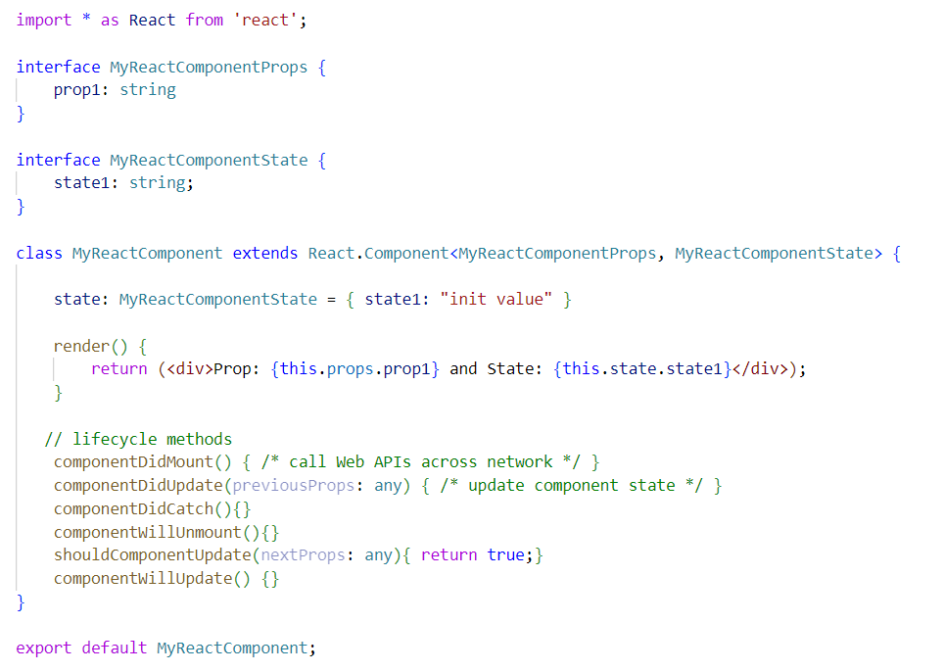
Migrating from Classic React to Modern React
Classic React based on class-based components and lifecycle method
Modern React based on functional components and hooks
Class React with Class-based Components
Modern React with Functional Components

Slide 8
Hooks with which you should be familiar…
Hooks provided by React-JS and the React Router
useState
useEffect
useLayoutEffect
useRef
useContext
useNavigate

Slide 9
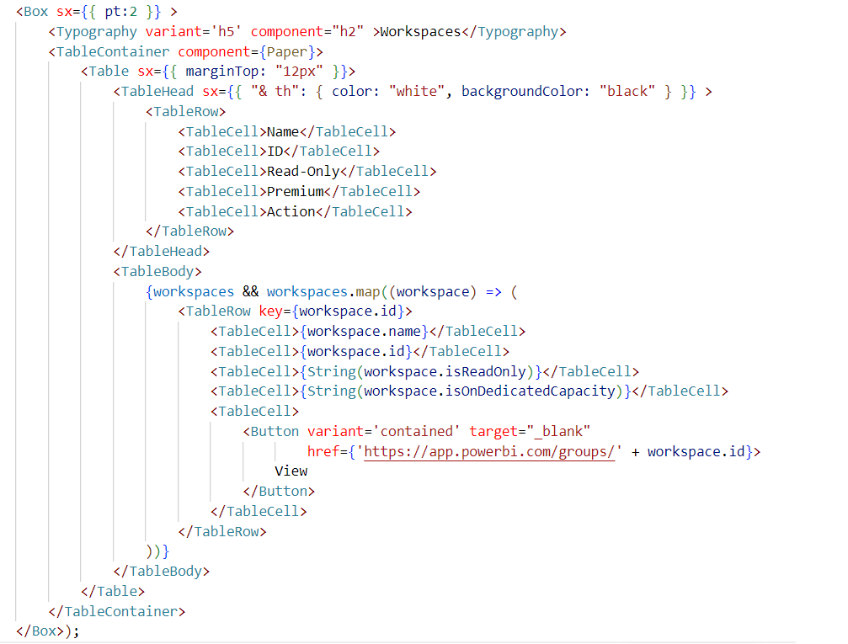
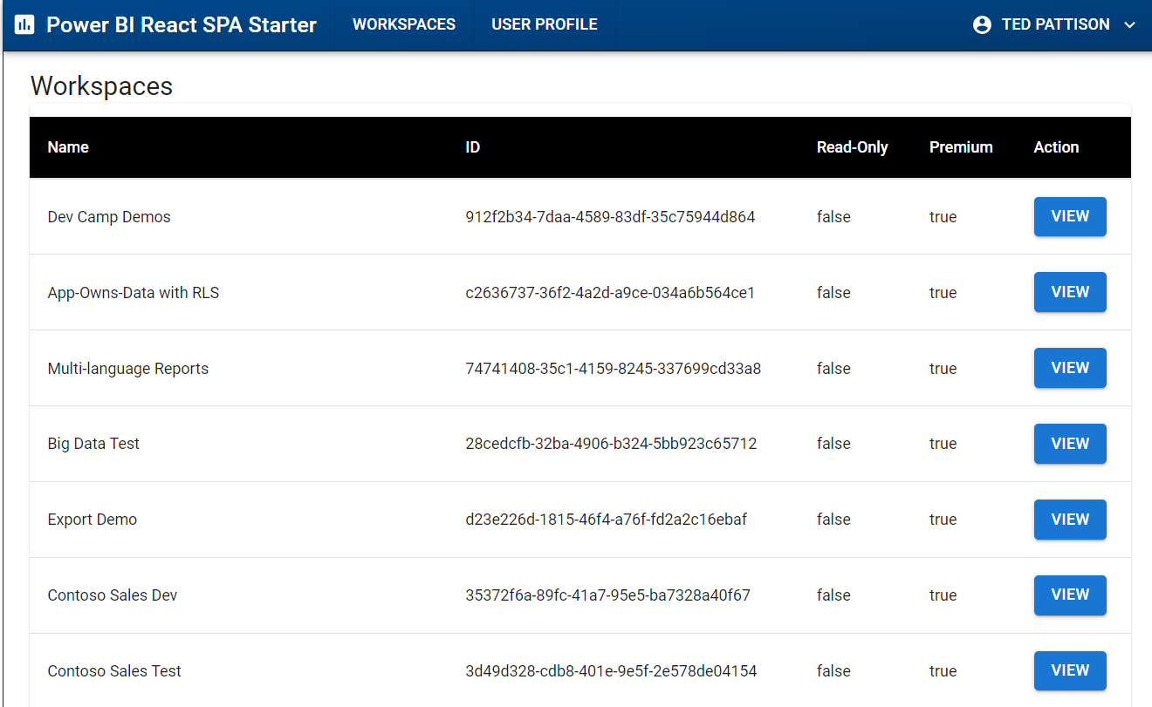
Working with React Components from Material UI
Import Material UI Components
Build UI using Material UI components

Slide 10
MSAL.js V 2.0
Microsoft Authentication Library for JavaScript
Authenticates SPA users with Azure AD
Install using node.js - npm i @azure/msal-browser
Docs: https://github.com/AzureAD/microsoft-authentication-library-for-js

Slide 11
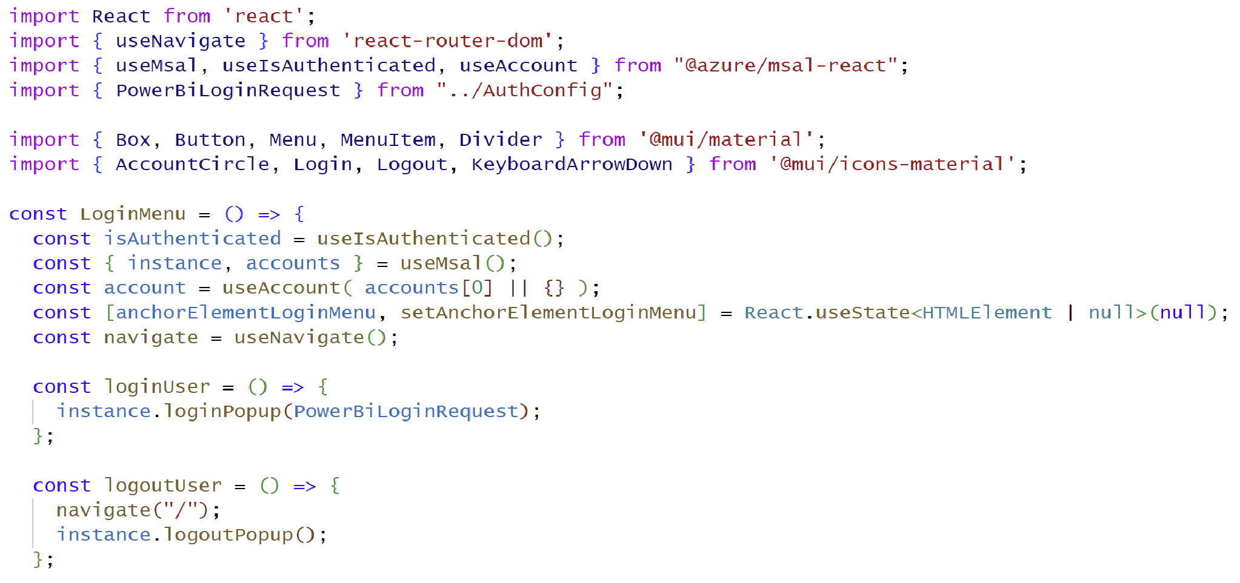
MSAL Component for React (@azure/msal-react)
msal-react library is consumed by using hooks
useIsAuthenticated
useMsal
useAccount

Slide 12
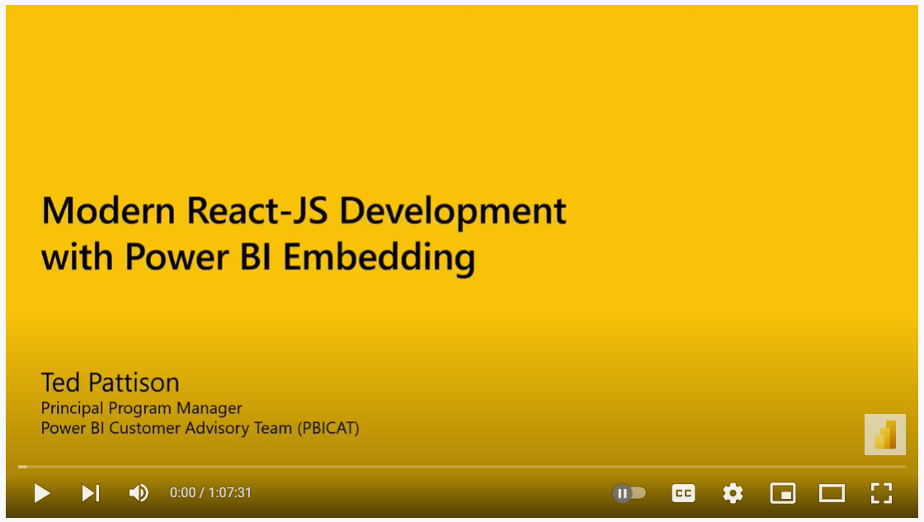
Watch the August 2022 Session of Power BI Dev Camp
Session 25 - Modern React-JS Development with Power BI Embedding
Provides more detail on technical content covered in this review section
Accompanied by developer code samples demonstrating modern React-JS development
https://www.powerbidevcamp.net/sessions/session25/

Slide 13
Agenda
Quick Review of Modern React
App-Owns-Data Starter Kit Architecture
Designing a View Model for a Multitenant Application
Designing a Functional Component for Embedding Reports
Managing Embed Token Expiration
Providing Users with Export-to-File Commands
Designing a Self-service Authoring Experience

Slide 14
App-Owns-Data Starter Kit Architecture
AppOwnsDataDB: custom database to track tenants, user permissions and user activity
AppOwnsDataAdmin: administrative app to create tenants and manage user permissions
AppOwnsDataWebApi: custom Web API used by client-side SPA applications
AppOwnsDataClient: customer-facing SPA used to view and author reports (JavaScript & JQuery)
AppOwnsDataReactClient : customer-facing SPA used to view and author reports (modern React-JS)
AppOwnsDataAdmin
AppOwnsDataDB
Power BI REST API
AppOwnsDataClient
AppOwnsDataWebApi
AppOwnsDataReactClient

Slide 15
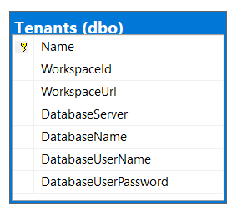
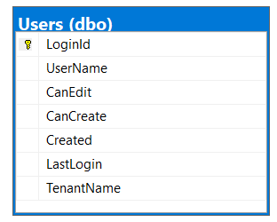
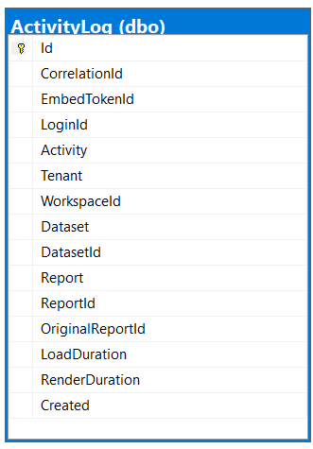
Database Schema for AppOwnsDataDB
Tenants table tracks Power BI workspace Id and customer database connection info
Users table tracks user profile with tenant assignment and permissions within tenant
ActivityLog table tracks telemetry data about user activity and report performance

Slide 16
AppOwnsDataWebApi
Provides secure Web API endpoints for AppOwnsDataReactClient
Used to process user login
Used to retrieve embedding data and embed tokens
Used to log activity events
Used to enable on-demand exporting of reports
AppOwnsDataReactClient
AppOwnsDataWebApi
Power BI REST API
Your choice of identity provider
Azure AD App Service Principal
AppOwnsDataDB

Slide 17
AppOwnsDataWebApi Controllers
UserLogin
Called by client SPA once after user authenticates
Embed
Called to retrieve embedding data for a specific tenant
EmbedToken
Called to retrieve new embed token
ActivityLog
Called to post activity event to custom audit log
ExportToFile
Called in response to user action to export report to file
AppOwnsDataReactClient
AppOwnsDataWebApi

Slide 18
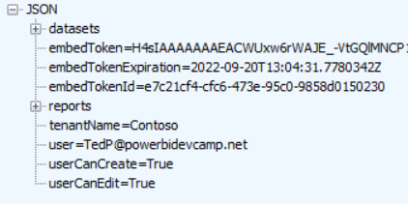
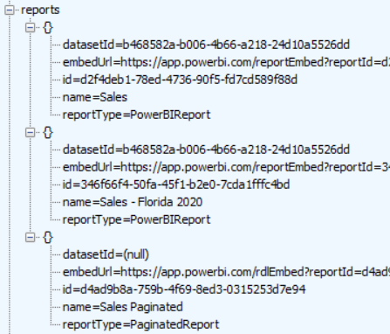
Embedding Data View Model
AppOwnsDataWebApi returns view model to AppOwnsDataReactClient
AppOwnsDataReactClient
EmbedController
AppOwnsDataWebApi
JSON

Slide 19
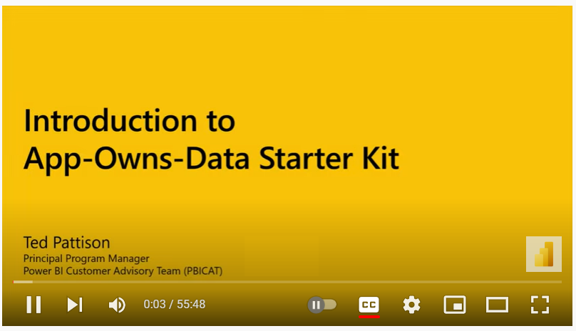
Watch the July 2021 Session of Power BI Dev Camp
Session 11 - Modern React-JS Development with Power BI Embedding
Provides more detail on AppOwnsDataAdmin and AppOwnsDataWebApi
Dev Camp Video: https://www.youtube.com/watch?v=u56R_c9K7rY
Links and Details: https://www.powerbidevcamp.net/sessions/session11/

Slide 20
Agenda
Quick Review of Modern React
App-Owns-Data Starter Kit Architecture
Designing a View Model for a Multitenant Application
Designing a Functional Component for Embedding Reports
Managing Embed Token Expiration
Providing Users with Export-to-File Commands
Designing a Self-service Authoring Experience

Slide 21
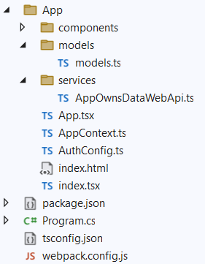
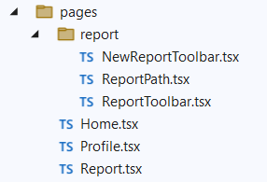
AppOwnsDataReactClent Application Structure
AppOwnsDataReactClent used to develop client-side SPA application with React-JS
Webpack utility used to compile Typescript code to JavaScript
All Typescript code for SPA located inside App folder
Code to call Web API encapsulated in AppOwnsDatWebApi.ts
React components located inside the components folder
Pages used by React Router located inside the pages folder

Slide 22
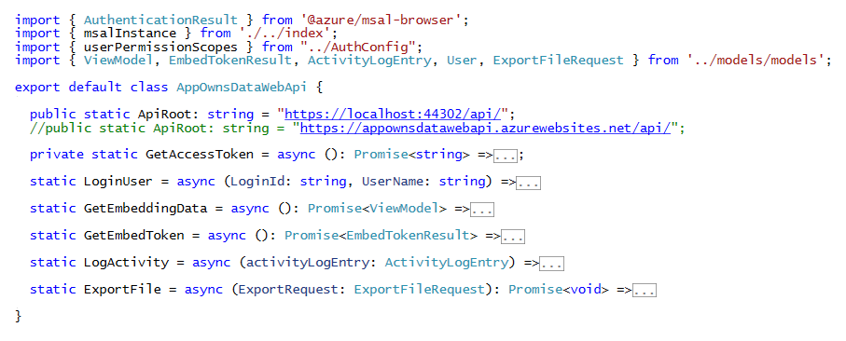
AppOwnsDataWebApi Wrapper Class
AppOwnsDataWebApi is wrapper class to call external API

Slide 23
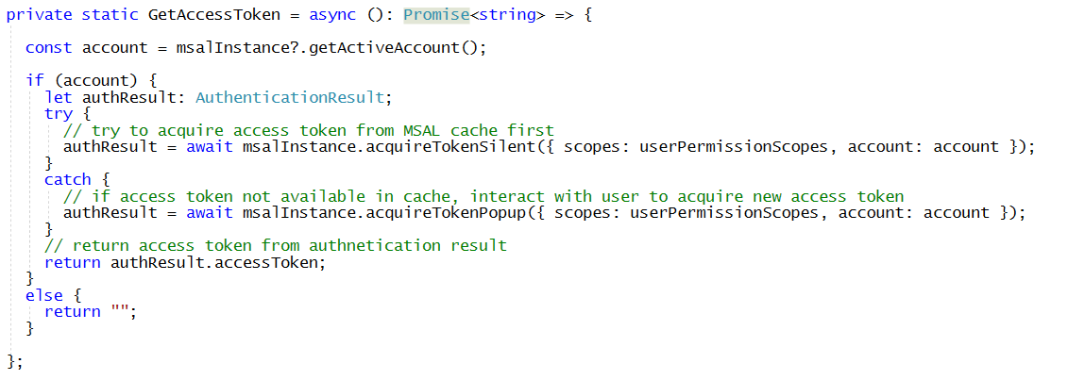
AppOwnsDataWebApi.GetAccessToken
GetAccessToken uses msalInstance object which is initialized in index.tsx
First attempt is made using acquireTokenSilent to acquire token from browser cache
Second attempt is made using acquireTokenPopup which triggers user interaction

Slide 24
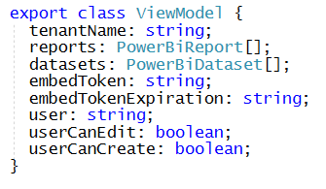
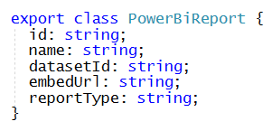
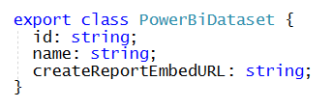
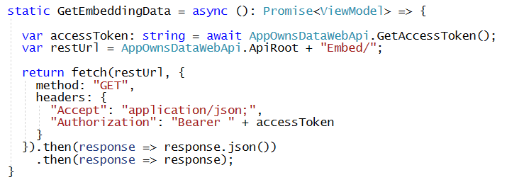
AppOwnsDataWebApi.GetEmbeddingData
GetEmbeddingData uses serialization types defined in models.ts
GetEmbeddingData uses fetch API to call across network

Slide 25
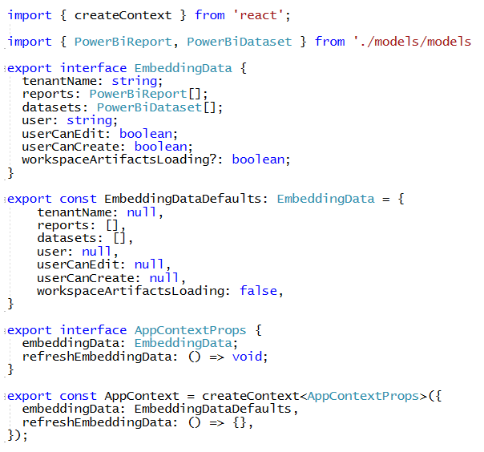
AppContext.ts
React-JS provides context feature for sharing state across components
Designing with context lessens the need to pass parameters between components
Context includes state properties which can be shared with child components
Context can also contain modifier methods allowing child components to modify context state

Slide 26
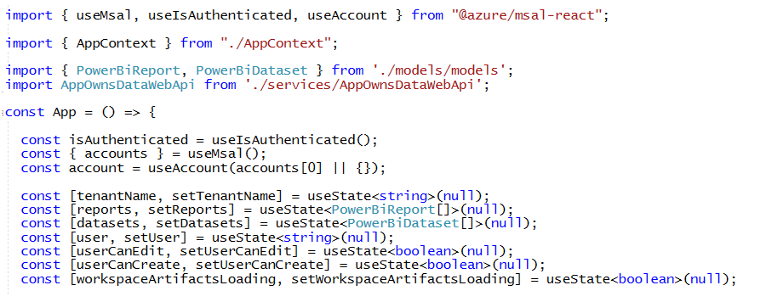
Storing State for Application Context in App.tsx
The state for application context is managed by App.tsx
App.tsx utilizes useState hook to track state for application context

Slide 27
Initializing Application Context with useEffect Hook
useEffect is hook used to execute code after React has committed changes to DOM
Using useEffect is best practice when executing code which calls Web APIs across the network
Results from Web API call in useEffect function can be used to modify component state

Slide 28
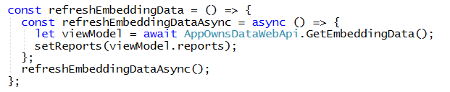
refreshEmbeddingData in App.tsx
refreshEmbeddingData method used to refresh embedding data
This method must be called after the user creates a new report
Reference to refreshEmbeddingData passed to child components in context

Slide 29
Making Context Available to Child Components
App.tsx contains context AppContext.Provider tag
AppContext.Provider tag used to associate context data with component state in App.tsx
AppContext.Provider tag passes reference to refreshEmbeddingData

Slide 30
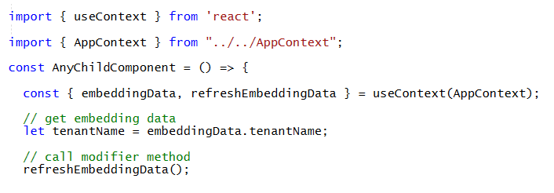
Using AppContext in a Child Component
Import AppContext type into child component
Create context in child component using useContext hook
Use context state properties and modifier methods anywhere in child component

Slide 31
Agenda
Quick Review of Modern React
App-Owns-Data Starter Kit Architecture
Designing a View Model for a Multitenant Application
Designing a Functional Component for Embedding Reports
Managing Embed Token Expiration
Providing Users with Export-to-File Commands
Designing a Self-service Authoring Experience

Slide 32
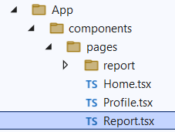
Report.tsx
Report.tsx contains programming logic used to embed reports
Uses routing parameters to parse the ID of a report or dataset from URL
Acquires embed tokens and manages embed token lifetime
Uses the Power BI JavaScript API to embed reports
Leverages child components in report folder such as ReportToolbar.tsx and ReportPath.tsx

Slide 33
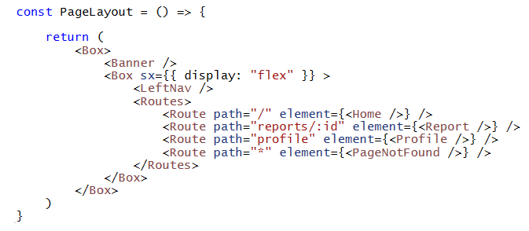
Routing to Report.tsx with a Report ID or Dataset ID
AppOwnsDataReactClient uses a custom routing scheme with React Router
Routing scheme for application defined in PageLayout.tsx
Path for routing to existing report: /reports/{ReportId}
Path for routing to new report: /reports/{DatasetId}
LeftNav.tsx provides menu allowing user to navigate to route with Report ID or Dataset ID
Report.tsx contains code to inspect route and determine ID for target report or dataset

Slide 34
Retrieving the ID Parameter from the Route Path
Route path to Reports.tsx defines path parameter named id
The id parameter has value of URL segment after reports/
The id parameter can be retrieved in Reports.tsx using useParams hook

Slide 35
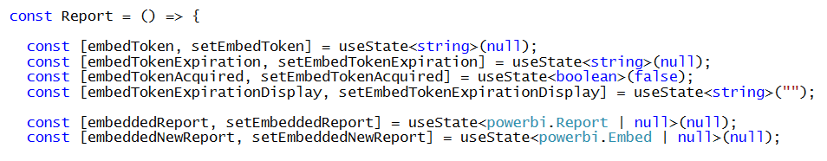
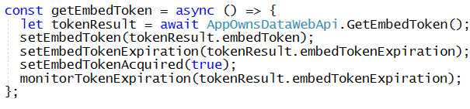
Getting Embed Tokens in Report.tsx
Report.tsx has state properties for storing embed token and related data
GetEmbedToken retrieves embed token data and stores it in state properties

Slide 36
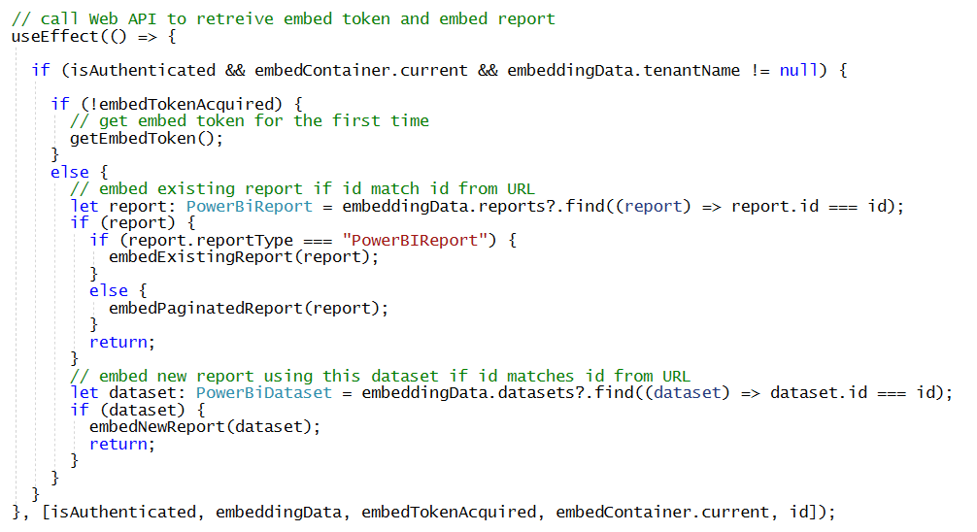
Initialization Logic in Report.tsx
useEffect contains logic to acquire embed token and start embedding process
Ensures embed token has been acquired
Performs ID lookup on reports and datasets to dispatch to embed processing function

Slide 37
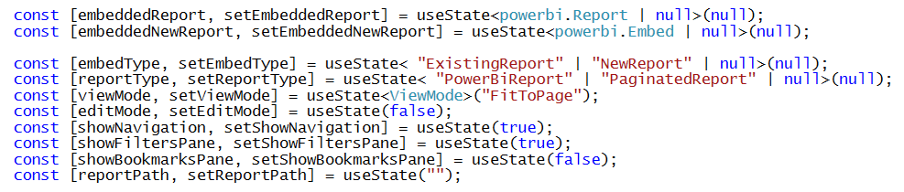
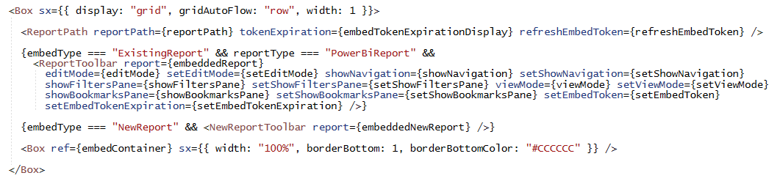
Report.tsx Output
State properties in Report.tsx used to track report metadata
Report.tsx output adds embedContainer and child components
Report.tsx state properties passed to ReportToolbar.tsx

Slide 38
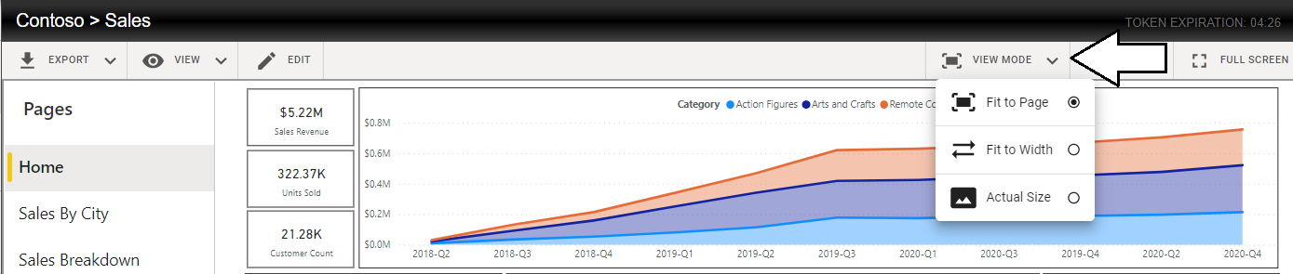
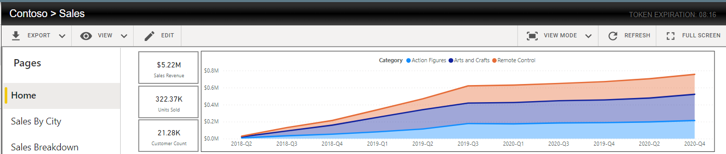
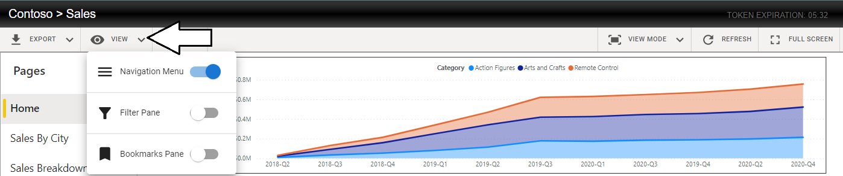
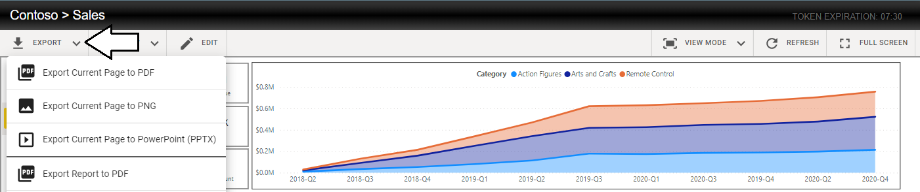
ReportToolbar.tsx
ReportToolbar.tsx provides menu options to report consumers

Slide 39
Agenda
Quick Review of Modern React
App-Owns-Data Starter Kit Architecture
Designing a View Model for a Multitenant Application
Designing a Functional Component for Embedding Reports
Managing Embed Token Expiration
Providing Users with Export-to-File Commands
Designing a Self-service Authoring Experience

Slide 40
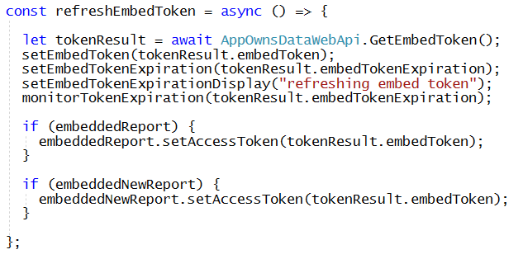
refreshEmbedToken in Report.tsx
refreshEmbedToken calls AppOwnsDataWebApi to get new embed token
Called to prevent embed token from expiring
Called whenever a new report Is created

Slide 41
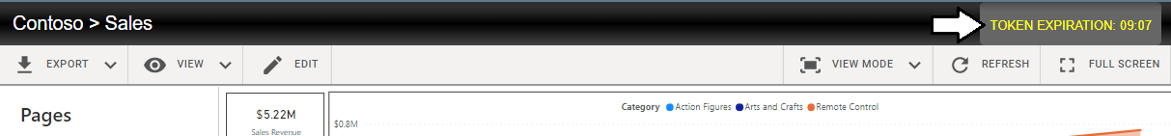
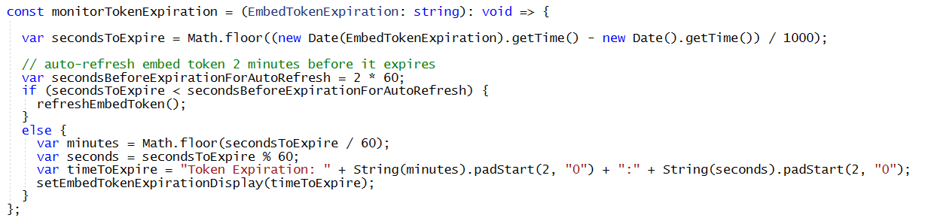
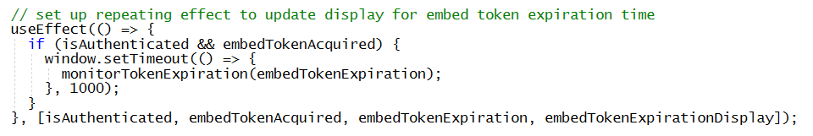
Embed Token Auto-refresh Strategy
Token expiration time displayed to user with ReportPath.tsx
monitorTokenExpiration calls refreshEmbedToken if expiration is two minutes away or less
useEffect function calls setTimeout to periodically call monitorTokenExpiration once a minute

Slide 42
Agenda
Quick Review of Modern React
App-Owns-Data Starter Kit Architecture
Designing a View Model for a Multitenant Application
Designing a Functional Component for Embedding Reports
Managing Embed Token Expiration
Providing Users with Export-to-File Commands
Designing a Self-service Authoring Experience

Slide 43
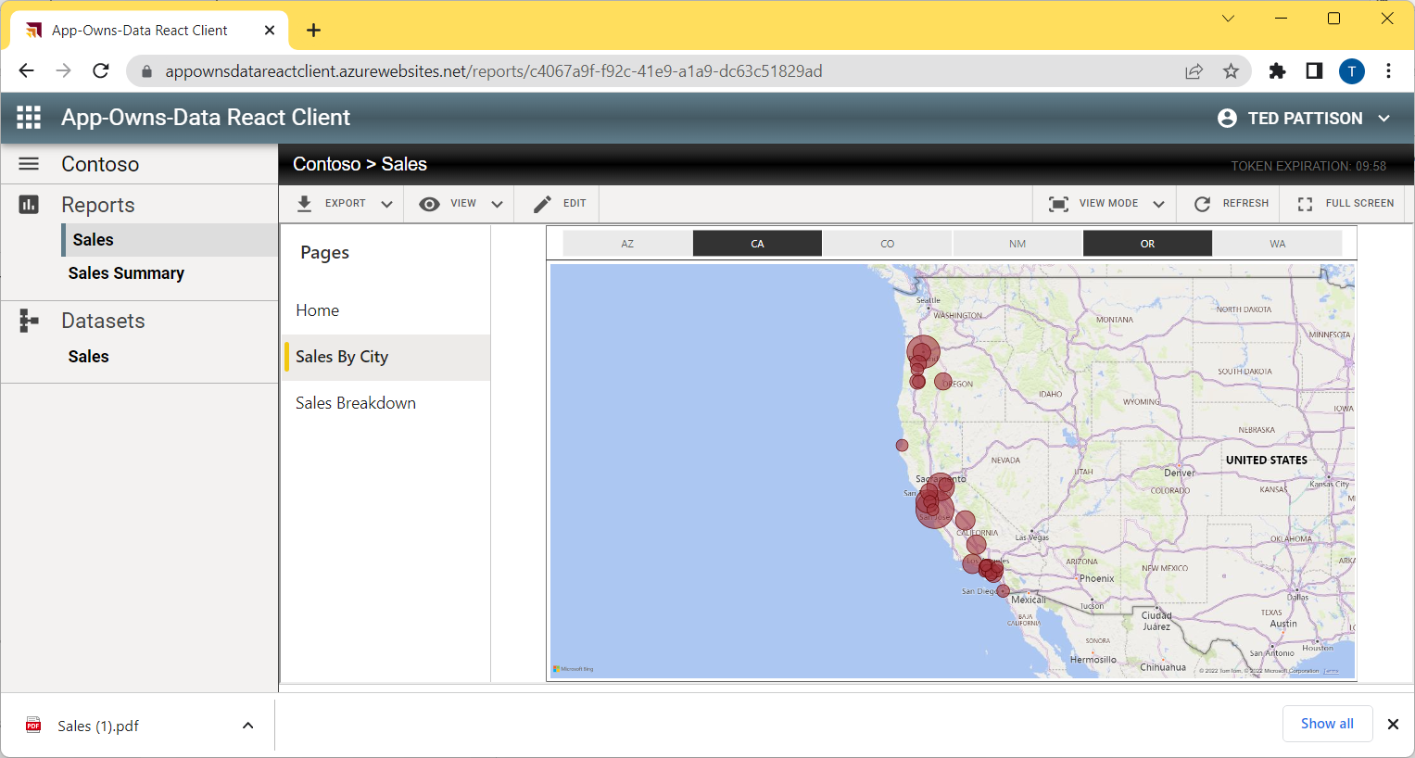
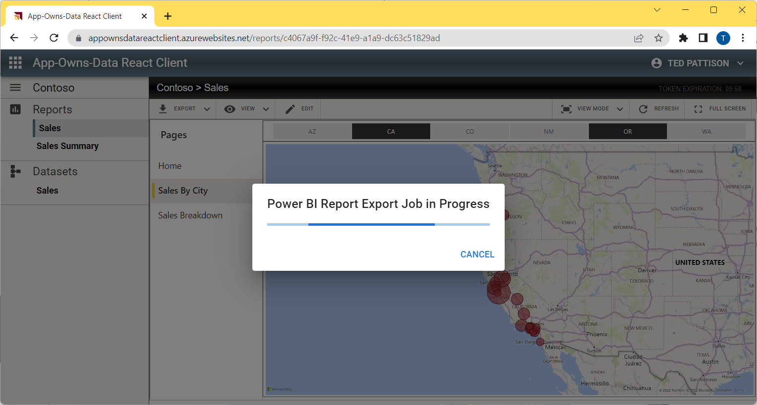
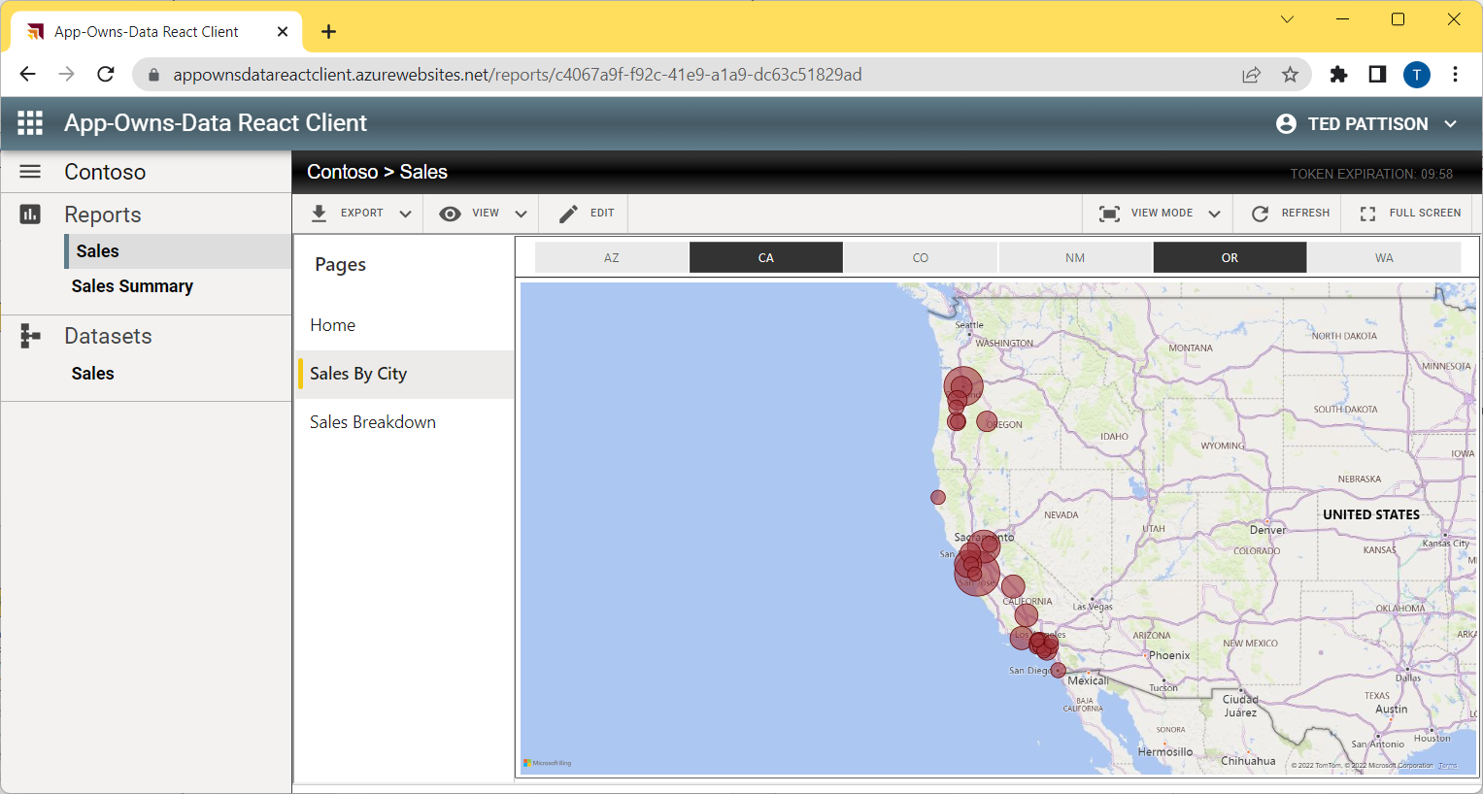
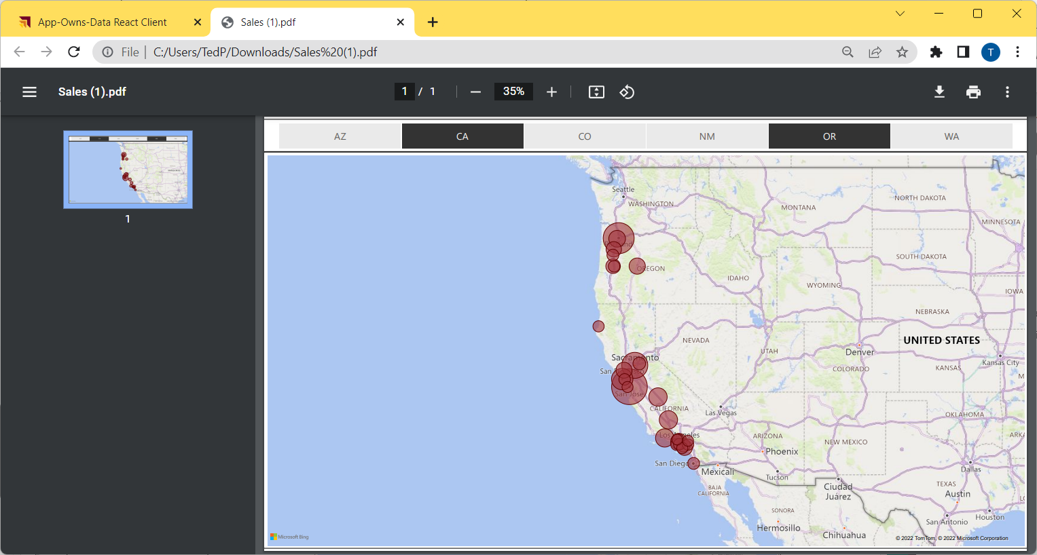
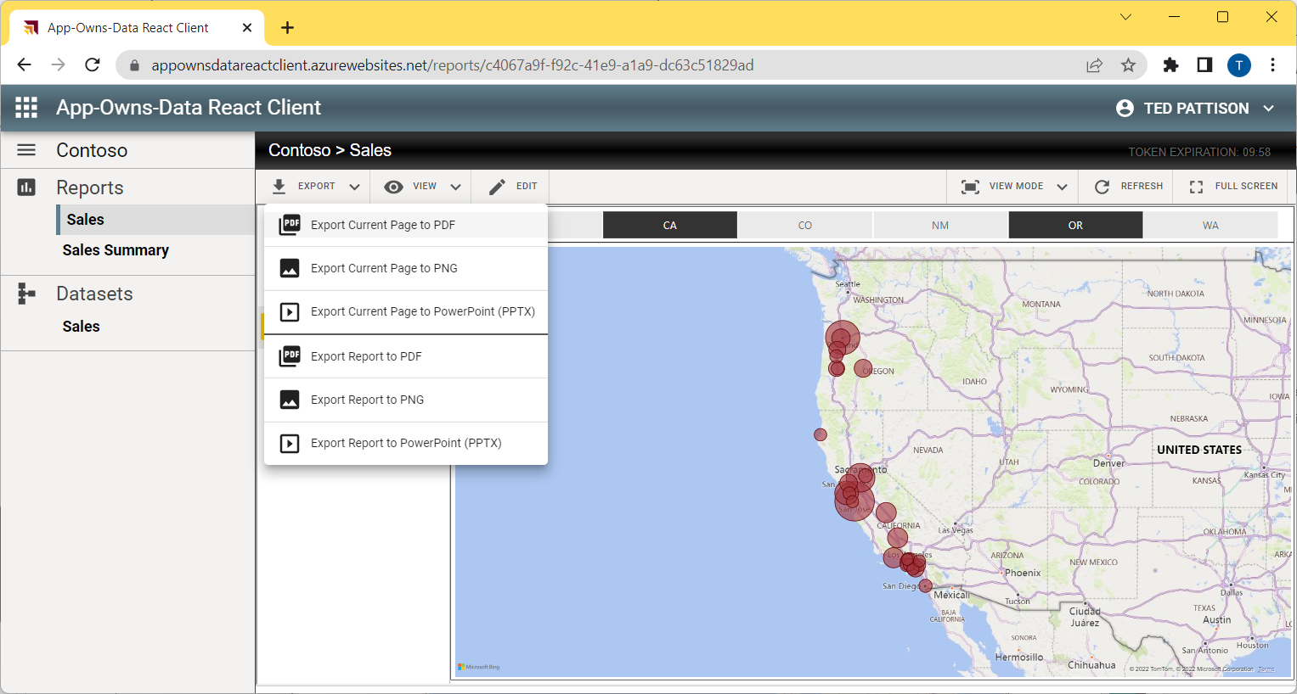
User Experience for Exporting Reports

Slide 44
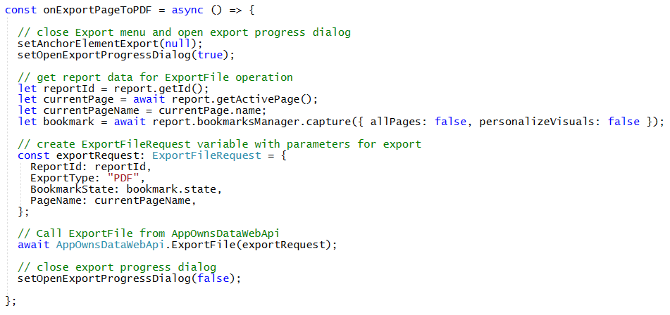
Capturing Bookmark State and Active Page Name
Creating a richer user experience for exporting reports
Export report with same filtering as the users sees in browser
Give choice to export current page or all visible report pages
Power BI JavaScript API provides access to data about current report
Active page name can be captured dynamically using getActivePage and name
Bookmark can be captured dynamically using bookmarkManager.capture
Custom bookmark state used to pass current filtering state to export job

Slide 45
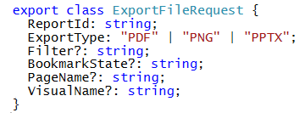
Calling AppOwnsDataWebApi.ExportFile
ExportFileReqest defined in models.ts
Sample event handler in ReportToolbar.tsx for exporting single page to PDF

Slide 46
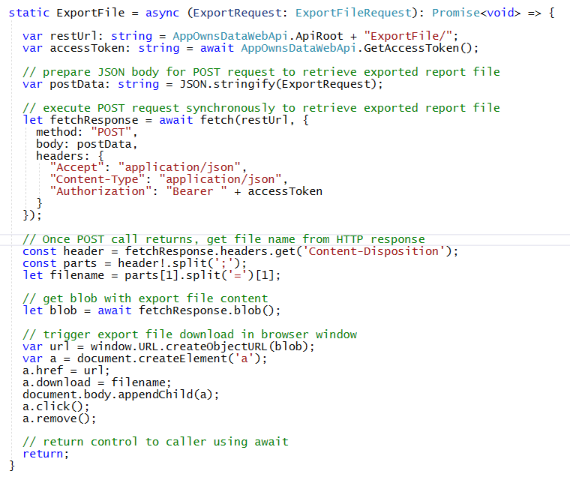
AppOwnsDataWebApi.ExportFile Implementation

Slide 47
App-Owns-Data Starter Kit Export Processing Architecture
AppOwnsDataReactClient
AppOwnsDataWebApi
Power BI REST API
https://localhost:44302/ExportFile
synchronous
blocking call
ExportToFileInGroup
asynchronous
non blocking call
GetExportToFileStatusInGroup
Exported
File
Exported
File
Exported
File
ExportFile API Response
GetFileOfExportToFileInGroup

Slide 48
App-Owns-Data Embedding with Paginated Reports
Embedded paginated reports automatically display built-in Export menu
User can use Export menu to download export by hand in any available format
No need to include custom web API as with exporting Power BI report with App-Owns-Data

Slide 49

Review the Dev Camp Session on the Power BI Export API
Session 16: Using the Power BI Export API to Generate PDF and Image Files
Webinar Recording: https://youtu.be/ybWWTVt_guA
Links and Resources: https://www.powerbidevcamp.net/sessions/session16/

Slide 50
Agenda
Quick Review of Modern React
App-Owns-Data Starter Kit Architecture
Designing a View Model for a Multitenant Application
Designing a Functional Component for Embedding Reports
Managing Embed Token Expiration
Providing Users with Export-to-File Commands
Designing a Self-service Authoring Experience

Slide 51
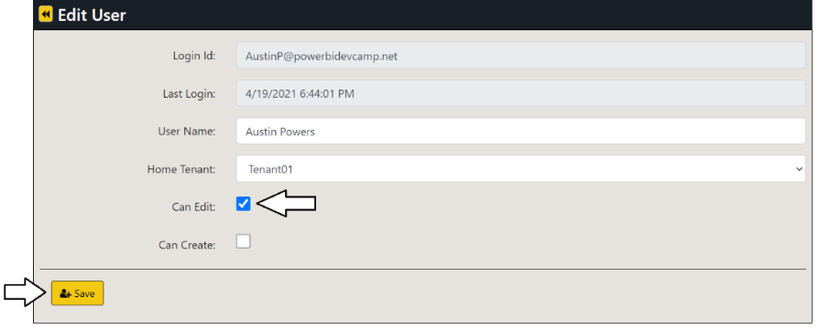
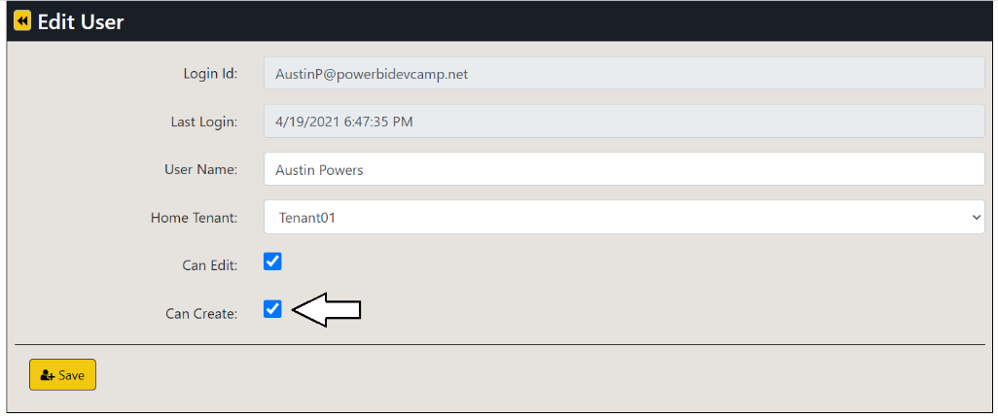
Setting User Permissions in AppOwnsDataAdmin
Setting Can Edit allows user to edit and save changes to existing report
Setting Can Create allows user to create new reports

Slide 52


Edit reports using AppOwnsDataReactClient
User with Can Edit permissions can move report into edit mode
Once in edit mode, report author can customize report and save changes

Slide 53

Create New Content using AppOwnsDataClient
User with Can Create permissions can create new reports
User can use Save As command on report in edit mode to copy a report
User can click dataset link in Datasets section to create new report

Slide 54

Refreshing EmbedToken and EmbeddingData
Creating new report invalidates embed token and embedding data
EmbedToken does not contain report ID for new report
EmbeddingData does not contain new report in Reports collection
What happens when new report is created with Save As command?
Call to refreshEmbedToken
Call to refreshEmbeddinfData
Log CopyReport activity event
Navigate to URL with ID of new report

Slide 55
Summary
Quick Review of Modern React
App-Owns-Data Starter Kit Architecture
Designing a View Model for a Multitenant Application
Designing a Functional Component for Embedding Reports
Managing Embed Token Expiration
Providing Users with Export-to-File Commands
Designing a Self-service Authoring Experience

Slide 56
Call to Action
Download and try out the App-Owns-Data Starter Kit and AppOwnsDataReactClient
https://github.com/PowerBiDevCamp/App-Owns-Data-Starter-Kit
Learn more about modern React
https://beta.reactjs.org
Join Power BI Dev Camp Next Month for More React Coverage
Next month’s session covers using Azure B2C authentication with App-Owns-Data embedding
https://aka.ms/devcamplive
Live and Love the Power BI Community
https://community.powerbi.com/

Slide 57
Microsoft Power BI
Questions?

